Slide 1
Logging & Monitoring
How to make DevOps happy.
Joel Hammond-Turner
E: joel@hammond-turner.org.uk
T: @Rammesses
Notes:
Intro self
Big up LMK

Slide 2
DevOps – it’s just pushing the deploy button, Right?
It’s all about the “Ops”
It’s … MANAGING your software in a PRODUCTION environment
Understanding
Notes:
Introduce Karl & Olly
Explain project Stratus

Slide 3

DevOps – it’s just pushing the deploy button, Right?
Infrastructure affects your software
Your software affects infrastructure
Load balancing / Fail over
How DO you detect a failure?
Errors
Silent / deadly / annoying
Virtualised Servers
Resource management across VM estate - performance.

Slide 4

1: Health Monitoring
Is the software even running?
Is it “healthy”?
Service Connectivity
DB
Web services
Service busses
Is performance within expected limits?

Slide 5

2: Performance Monitoring
How many? How often? How fast?
Analyse critical sections
External Calls
DB calls
Don’t just rely on performance devtools
You NEED live performance data
Notes:
5+ Gb of raw COMPRESSED data from an F1 car in a 90 minute session. 5 BILLION samples / day

Slide 6

3: Exceptions
You should NEVER see these in your logs
It’s a scenario you’ve not coded for.
Always capture as much data as possible
Inner / aggregate exceptions
Raygun.io
DO NOT IGNORE
EXCEPTIONS!

Slide 7

4: Forensic Logging
Log as if you don’t have anything else
When something goes wrong can you diagnose from logging alone?
Provide context to every log line
User Id, Session Id, Activity Id, etc.
One line of logging may be all you get

Slide 8
4: Forensic Logging
ATTEMPTS - “Started processing {contextId}”
DECISIONS - “Decided to do {action} to {contextId} because {reasons}”
PREPARATION - “About to do {action} to {contextId}”
SUCCESS - “Succeeded in doing {action} to {contextId}”
TIMINGS - “Took {elapsedMs}ms to do {action} to {contextId}”
COMPLETION - “Finished processing {contextId}”

Slide 9
4: Forensic Logging
Use logging levels appropriately… and consistently
Fatal – It’s dead
Error – It’s failed
Warning – It’s already fixed
Info – It’s working
Debug – Hi there! Hello back!
Verbose – cmp.b d1, d2
Notes:
FATAL – A major error has occurred, and the entire component (service, website, etc) will be torn down.
This would mean a windows service has failed completely, or a web application cannot start up.
Ops ABSOLUTELY need to investigate ASAP
ERROR – An error condition has been detected, and the current operation will FAIL.
Data for that request has been lost, and affected data items MAY be in an inconsistent state (depending on how good your transactional programming has been). Support or Ops SHOULD investigate, but the overall functioning of the SYSTEM isn’t necessarily impared.
Retrying the transaction should generally succeed.
WARNING – An error condition has been detected, but the current operation WILL still complete successfully
For example, the QGuard system warns when an unknown SyncID is detected, but handles the issue by dynamically adding that new SyncID to the database.
INFO – Important happy-path information (e.g. case operations, state changes, etc), including metrics & logic decisions affecting processing.
DEBG1/TRACE1 – Use for request / response pairs when calling out to an external service. Method entry/exit not really useful.
DEBG2/TRACE2 – Use for DETAILED logging Not-quite line-level logging, but realistic & practical logging that will help FORENSIC log analysis.

Slide 10
4: Forensic Logging
Use a log aggregator if you have many components
Splunk aggregates & provides search across your log lines.
If using Splunk, log for Splunk
Tag / Value pairs

Slide 11

in-code Tools
Instrumentation
Performance Counters, Stopwatch
Metrics.Net
Logging
Log4Net, EntLib Logging, Nlog, ETW, Serilog
Raygun.io, Splunk

Slide 12
Deep inspection Tools
App Dynamics
Instruments code on the fly
On-prem, or in-cloud (PAAS)
Azure App Insights
Instruments code on compilation
On-prem, PAAS or SAAS

Slide 13
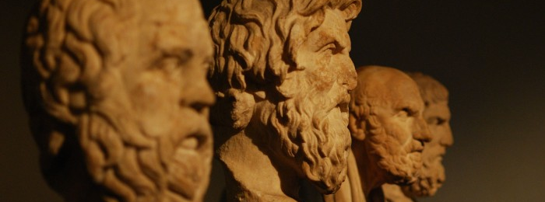
Sample – Akka Diners

Slide 14

Sample – Akka Diners
https://github.com/JoelHT-Landmark/AkkaDiners
Dining philosophers problem
WPF, C#
Akka.Net (Actor based)
Naïve implementation
Doesn’t work very well!

Slide 15
Sample – Akka Diners
Instrument - with Metrics.Net
Monitoring endpoint
Health indicators
Counters, Gauges, Histograms, Meters & Timers
Logging – with Serilog
Context – who / what / where
Output – Splunk
Logging Metrics.Net

Slide 16
Sample – Akka Diners
LET’S SEE THE CODE!

Slide 17
Metrics.Net
https://github.com/etishor/Metrics.Net
Instrumentation Helpers
Health monitoring
Monitoring endpoint
JSON / TXT
With pretty graphs!

Slide 18

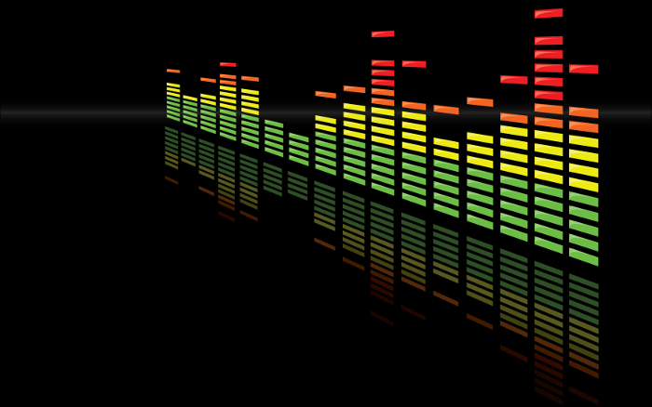

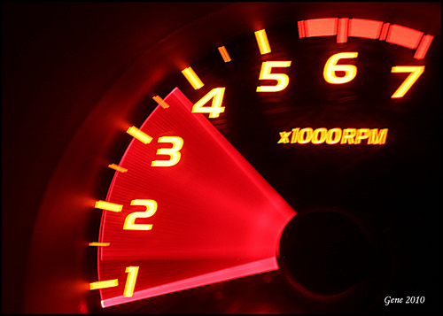
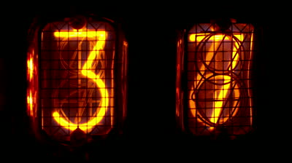
Metrics.net
Counters – Incrementing / Decrementing counts
Gauges – Instantaneous Values
Meters – Rates of events
Histograms – Distribution of stream values
Timers – How long did a code block take to execute?

Slide 19
Serilog
https://serilog.net
Yet another logging framework
Static logging / Instance logging / logging contexts
Build in data-based templating
Lots of output sinks – including Splunk

Slide 20
Splunk
https://splunk.com
Search and analysis tools for logs
Create reports and dashboards
Deep insight into machine data
Too much to show here!

Slide 21
Summary
DO
Instrument your code
Log like your life depends on it (it does)
Provide monitoring & health endpoints
Use deep-inspection tools (AppDynamics)
DON’T
Leave it for later – later is always too late.

Slide 22
Questions?
?

Slide 23
Logging & Monitoring
How to make DevOps happy.
http://bit.ly/happy-devops-cribsheet
Joel Hammond-Turner
E: joel@hammond-turner.org.uk
T: @Rammesses

